Slide 1


Fundamental of
3D Motion
By
Weitao Xiong
Advisor:
Prof. Hongfei Xue

Slide 2
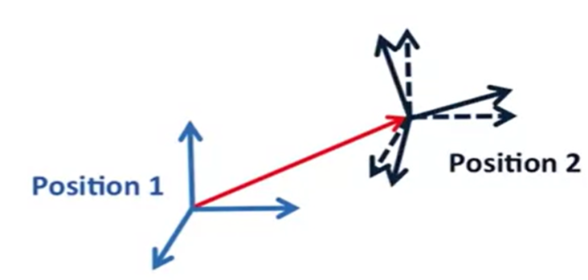
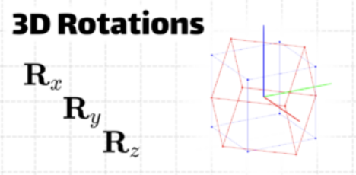
3D Motion consists of
Translation
pure rotation
Rotation is complex, it focus on
Rotation Matrix
Euler Angles
Gimbal Lock
Quaternion
Axis-Angle
3D Motion

Slide 3

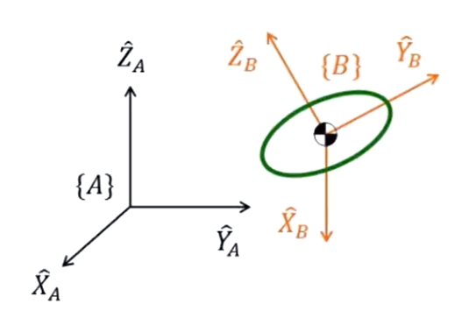
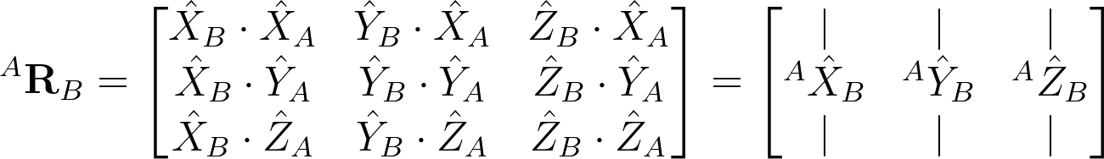
Rotation Matrix
First, it can describe the posture of {B} relative to {A}, {A} is global axis
Suppose each length of vectors is 1
Means the Projection of X_B on {A}
“direct cosines”

Slide 4
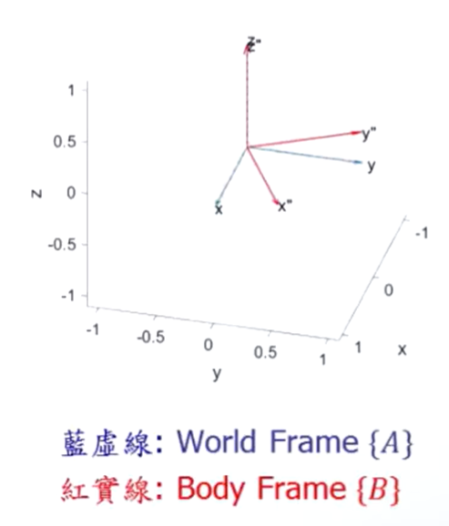
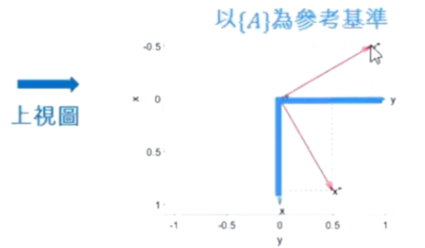
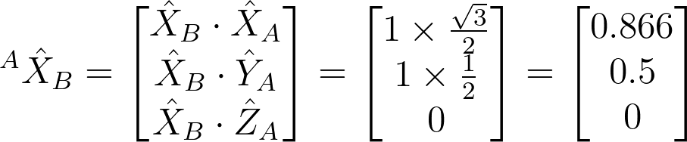
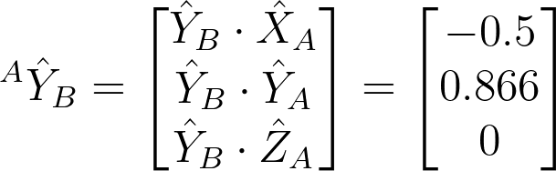
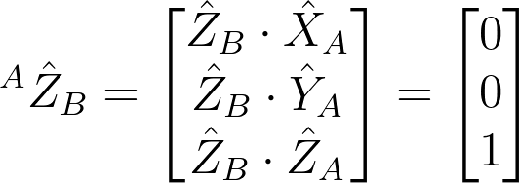
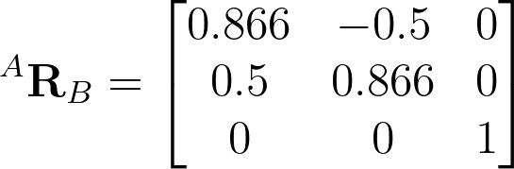
Ex:
The posture of {B} relative to {A}

Slide 5
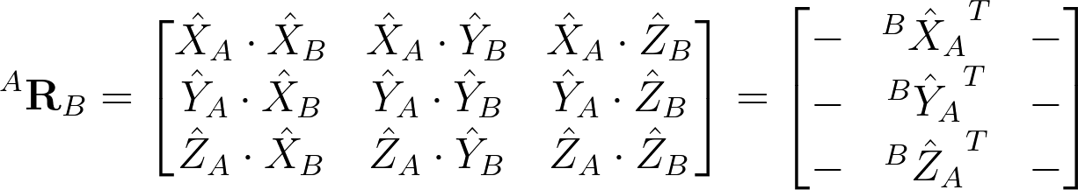
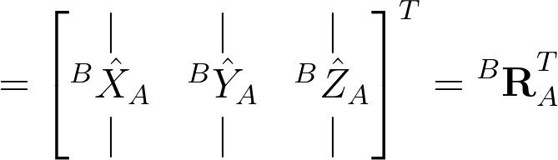
The result of swapping the front and back vectors remains unchanged
Means the Projection of X_A on {B}

Slide 6
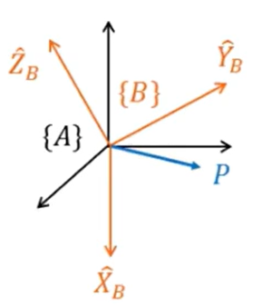
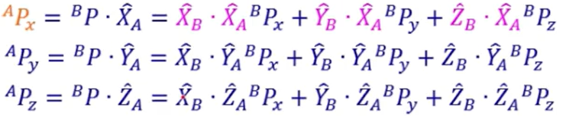
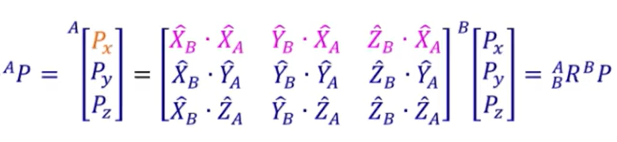
Second, it can convert the expression of a certain frame to another frame
Projection of vector P from {B} to {A}

Slide 7
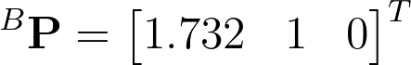
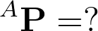
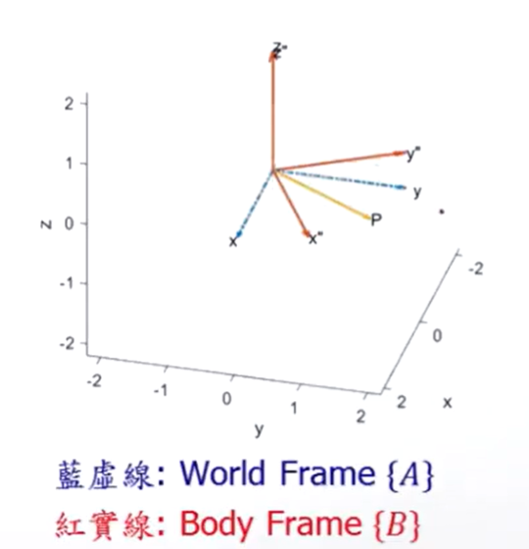

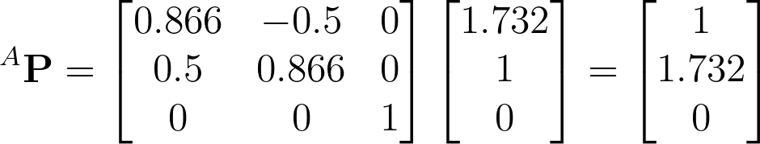

Slide 8
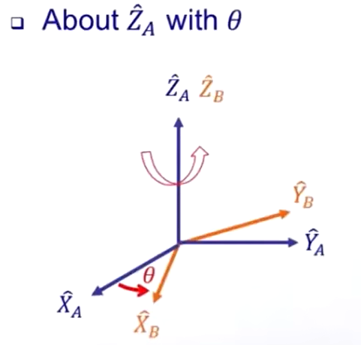
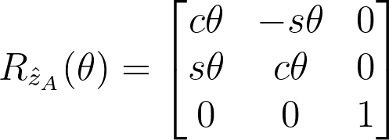
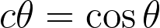
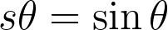
Third, it can further describe the rotational state of the object. Or, we could say rotate point(vector) in the same frame
Rotation angle (Counter Clockwise)
axis of rotation

Slide 9
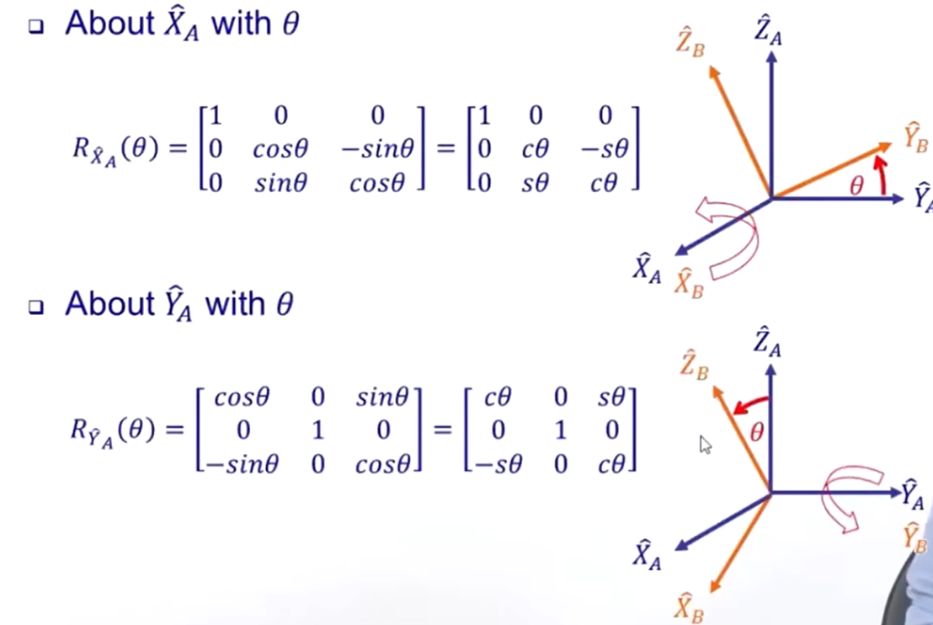

Slide 10
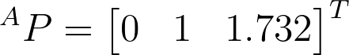
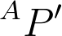
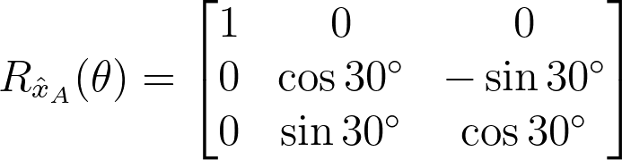
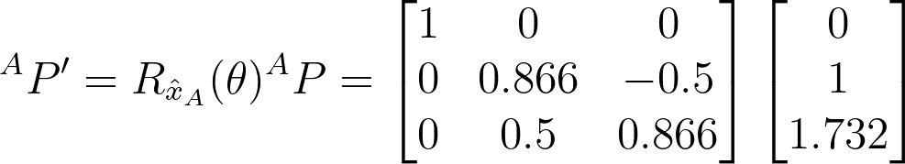
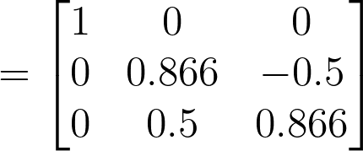
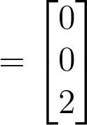
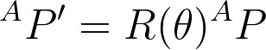
Ex:
Rotate 30 degrees to the x-axis, then find

Slide 11
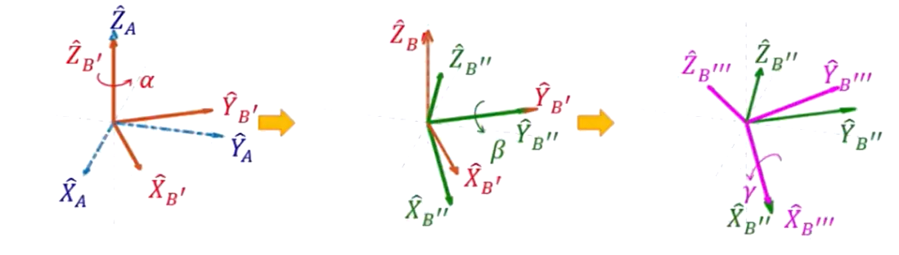
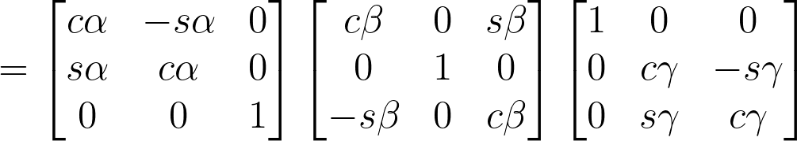
Euler Angle
Any rotation in 3D space can be split becomes a rotation along the three orthogonal coordinate axes of the object itself.
Matrix multiplication is not commutative, so different rotation orders will produce different results.
First is a Z-Y-X Euler Angle

Slide 12
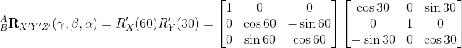
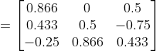
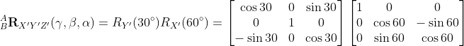
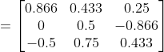
Ex:
What’s the difference between “first rotate the x-axis by 60, and then rotate the y-axis by 30” and “first rotate the y-axis by 30, and then rotate the x-axis by 60”
first rotate the x-axis by 60, and then rotate the y-axis by 30
first rotate the y-axis by 30, and then rotate the x-axis by 60

Slide 13
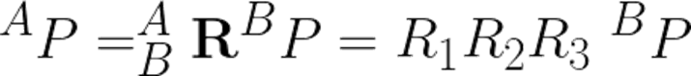

Slide 14
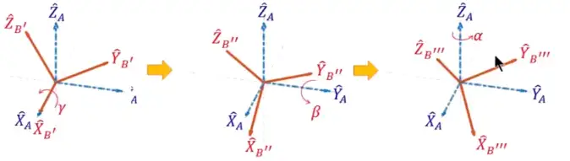
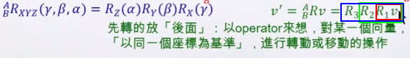
Fixed Angle
X-Y-Z fixed angle: The X, Y, and Z axes are fixed, as shown in the blue coordinate system as shown below (counterclockwise is positive)

Slide 15
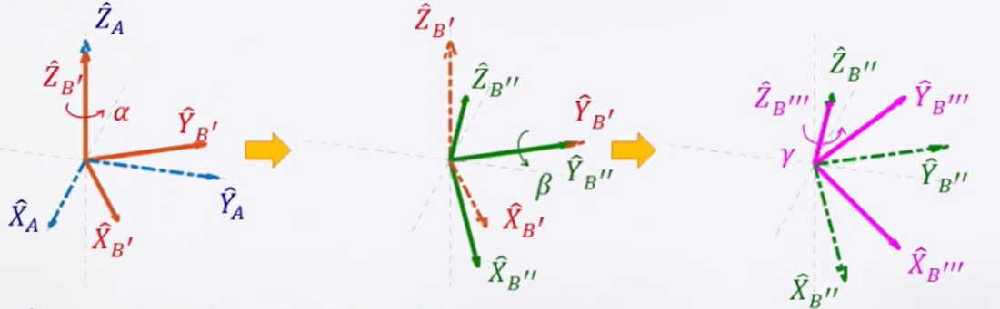
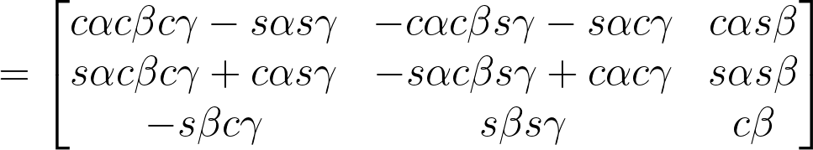
Second is a Z-Y-Z Euler Angle, which was used in robotics

Slide 16
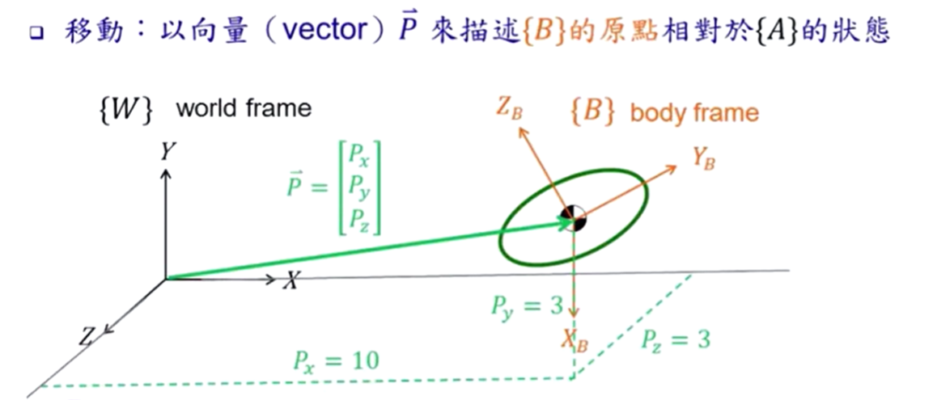
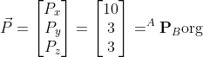
Moving

Slide 17
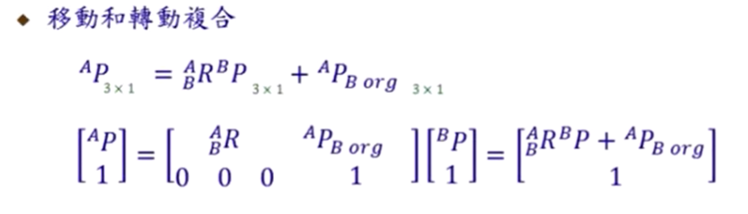
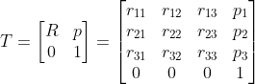
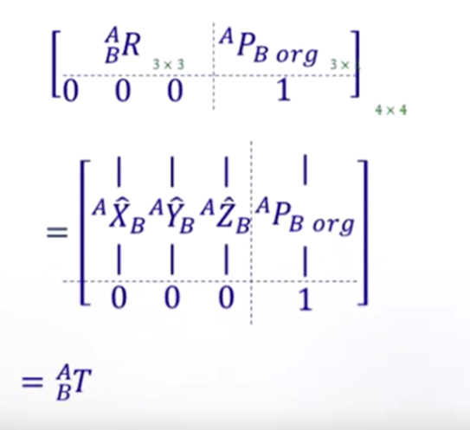
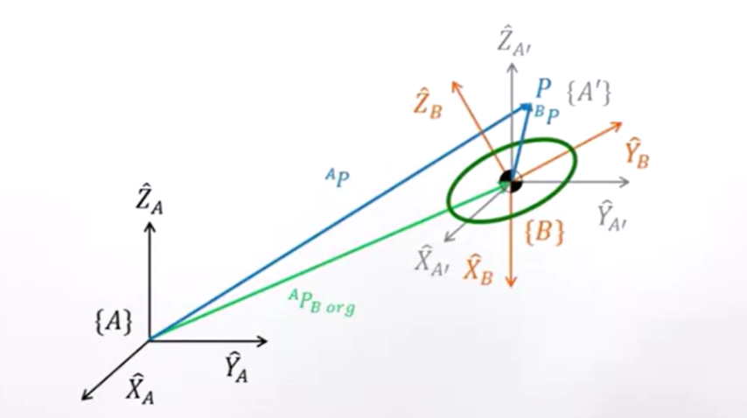
Mapping
We can use a Homogeneous transformation matrix to describe movement and Rotation

Slide 18
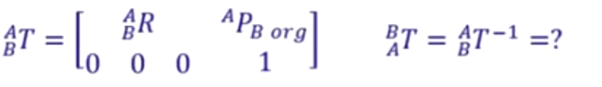
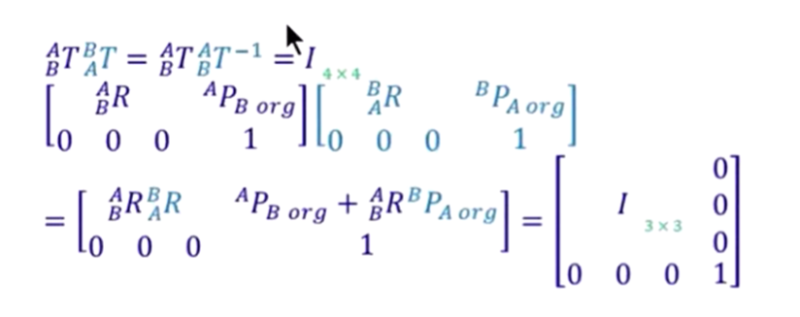


Inverse Transformation Matrix:

Slide 19





Inverse:

Slide 20

Ex:

Slide 21




Operator
In addition to Mapping, T can also be used as an Operator to move or rotate vectors (or points).

Slide 22


Slide 23


Slide 24




Transformation Matrix summary
Change point from the expression of a certain frame to another frame.
Move and rotate point(vector) in the same frame

Slide 25


Slide 26

Gimbal Lock
However, the Euler Angle is vulnerable to a gimbal lock.
Gimbal Lock is a phenomenon that occurs when two of the three axes of rotation of a 3D object align, resulting in a loss of one degree of freedom. So the system goes from 3 dimensions to 2 dimensions.
There are two ways to avoid this problem:
·Changing the rotation sequence, if you need to obtain a solution in Euler Angles this is the best way to avoid this problem.
·Using Quaternions, quaternions do not suffer gimbal lock.

Slide 27




Review Complex Number
Quaternion is quite similar to Complex Number. So first, let us review Complex Number
Magnitude:
Multiplication:
Matrix form of Z1
Vector form of Z2

Slide 28


2D Rotation: For example, the vector (4,1) will counterclockwise 30 degrees.
First, convert (4,1) to 4+1*I
Then

Slide 29




Quaternion
Quaternions:
Scalar
part
Imaginary
part
Vector
part
or
Multiplication:

Slide 30


Axis-Angle Representation of 3D Rotations
According to Euler's rotation theorem, any 3D rotation (or sequence of rotations) can be specified using two parameters: a unit vector that defines an axis of rotation; and an angle θ describing the magnitude of the rotation about that axis.
An axis-angle rotation can therefore be represented by four numbers as
(x̂, ŷ, ẑ) is a unit vector that defines the axis of rotation
θ is the amount of rotation around (x̂, ŷ, ẑ)

Slide 31

Convert Axis-Angle to Quaternion
If we know the axis-angle components (θ, x̂, ŷ, ẑ), we can convert to a rotation quaternion q as follows:
q = (q₀, q₁, q₂, q₃)

Slide 32


Using Quaternion to handle
3D Rotation
You first define that axis with a unit vector which will write as having i, j, and k components normalized so that the sum of the squares of those components is 1
Second, convert Axis-Angle to Quaternion

Slide 33

Visualization
https://eater.net/quaternions

Slide 34


Why use θ/2
Rodrigues' rotation formula
If we use θ in quaternion rotation, it actually rotates 2θ
For more detail about how to use Taylor Expansions to get Rodrigues' rotation formula
https://people.eecs.berkeley.edu/~ug/slide/pipeline/assignments/as5/rotation.html

Slide 35





Derived Rodrigues' rotation formula
We can then rewrite the equation like this
A vector moves from p(0), at the time t=0, to p(θ), at the time t=θ
ω is the rotation axis, Angular velocity is 1 rad/s
Instantaneous velocity: The instantaneous velocity is the velocity of the particle p at the point of the trajectory at any time t. It is the rate of change of the particle's position vector p to time, that is, the derivative

Slide 36






Matrix Exponential
Maclaurin series:
Let M be an n×n matrix, we can define the Matrix Exponential of M is

Slide 37










Slide 38







Taylor series

Slide 39


Quaternion Rotation Theorem

Slide 40
Summary
Single-axis rotations (use Euler)
Two-axis rotations(use Euler)
3-axis rotations(use quaternion)
No gimbal lock/changing axes.
Interpolation is smooth and direct.
Simple to do calculations with

Slide 41
Reference
Lei_ZM. (2019, May 30). 台大機器人學之運動學－林沛群. 哔哩哔哩_bilibili. https://www.bilibili.com/video/BV1v4411H7ez?p=1
3Blue1Brown. (2018, October 26). Quaternions and 3D rotation, explained interactively. YouTube. https://www.youtube.com/watch?v=zjMuIxRvygQ
Ena, A. (2022, October 3). Euler angles, rotations and gimbal lock, brief explanation. Medium. https://medium.com/@lalesena/euler-angles-rotations-and-gimbal-lock-brief-explanation-de1d4764170
Rotation quaternions, and how to use them. Quaternions. (n.d.). https://danceswithcode.net/engineeringnotes/quaternions/quaternions.html
Krasjet. (n.d.). Krasjet/Quaternion: A Brief Introduction to the quaternions and its applications in 3D geometry. GitHub. https://github.com/Krasjet/quaternion?tab=readme-ov-file

